Slide 1
Fresh Grads – Group Project
Life Insurance

Slide 2
Problem Statement
To create an Application for Life Insurance
Customer can login, view insurance policy available, buy policy, view policy details, view customer details.
Admin can perform the below tasks
Customer Management
Product Management
Order Management

Slide 3

Road map
Application will be developed in following Sprints –
Spring Boot + Rest Controller + Data JPA
Microservices

Slide 4
Modules
Customer Module
Product Module
Premium Module

Slide 5






Admin
Use-Case Diagrams
Add Product
Update Product
Delete Product
View policy Product
View Customer Product
Renew Policy
Guest
Customer
Update Profile
View Product Details
View Insurance Products
Buy The Insurance Products

Slide 6
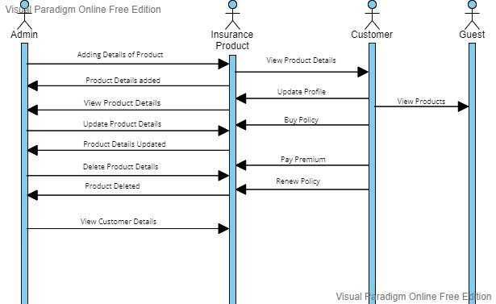
Sequence Diagram

Slide 7






POJO class
CustomerProduct
Customer
Order
cId : int
cName : String
cAge : int
cGender : String
cDOB : local date
cEmail : String
cAddrss : String
govId(aadhar/pan) : String
cId : int
productID : int
dateOfBuy : local date
dateofMaturity : local date
premiumType : string
premiumAmount : int
nomineeId : int
orderID : int
productID : int
premiumType : String
buyedDate : local date
Product
Nominee
CustomerPremiun
pId :int
productName : String
productPrice : int
Product duration: String
premimiumType: int
maturityAmount:double
beneficiaryAmt :double
productCreatedon:localdate
nomineeId : int
nomineeName : String
nomineeAge : int
nomineeGender : String
nomineeDOB : Local date
nomineeEmail : String
nomineeNum : int
nomineeAddress : String
govId(aadhar/pan) : String
cId : int
premiumAmount : double
dateOfPaid : local date
pId : int
nextDueDate : local date

Slide 8



ProductService
CustomerService
addProduct()
updateProduct() deleteProduct() viewProduct()
addNominee()
saveCustomer()
getCustomerById()
updateProfile()
OrderService
CustomerProduct
CustomerPremiun
SaveCustomerProduct()
Getcustomerproductdetails()
addPremium()
updatePremium()
deletePremium()
viewPremium()
Saveorder()
Getorderdetails()

Slide 9

Any Questions ?

